Slide 1
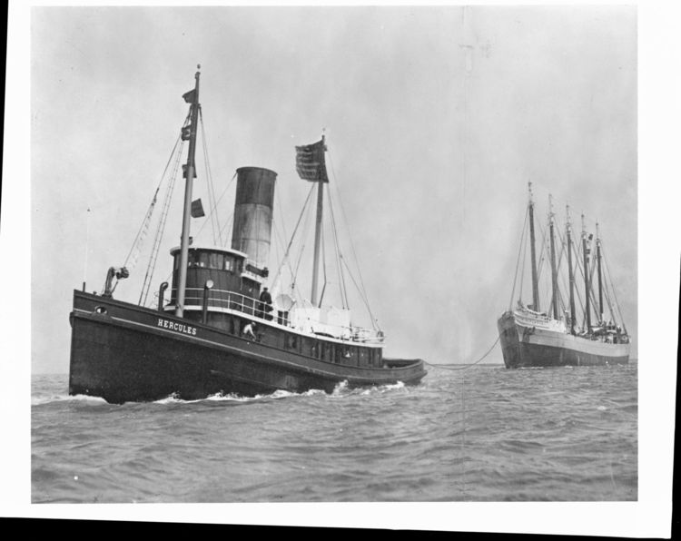
Circa 1910

Slide 2
Adventures of a Farm Boy who Became a Deep Sea Fireman; circa 1919
Out then the Golden Gate, the mostbeautiful harbor in the world...Thence south, empty, to Astoria where we picked up six million feet of timber in a raft to tow south to San Diego. Long, slow, lazy days, making no more than 3 knots₁...We rigged a fishing line on it and caught beautiful king salmon on the way. Catch one at 11 oclock, off with head and tail clean and slice into steaks. Ready to eat at 1130 and go on watch with full belly. The rest of us ateat 12 noon but there was alwaay plenty of salmon. We had no refrigerator, just a cooler on the top deck and the meat got pretty raunchy₂ after a couple of weeks, so lovely salmon was a Godsend.
“Knots” are the way that speed on a boat is measured. Going “3 knots” means that the boat is going slowly.
Smelly.

Slide 3
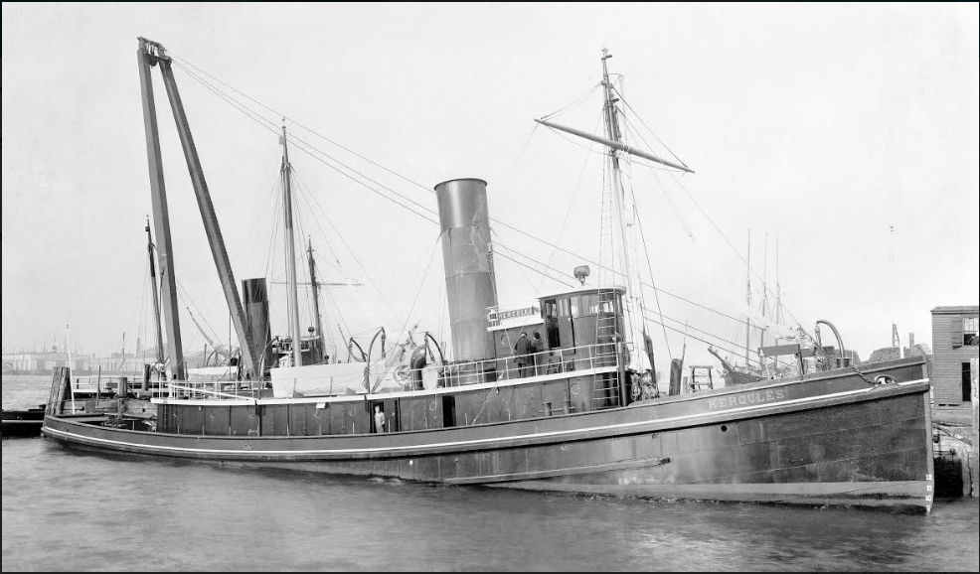
1908

Slide 4
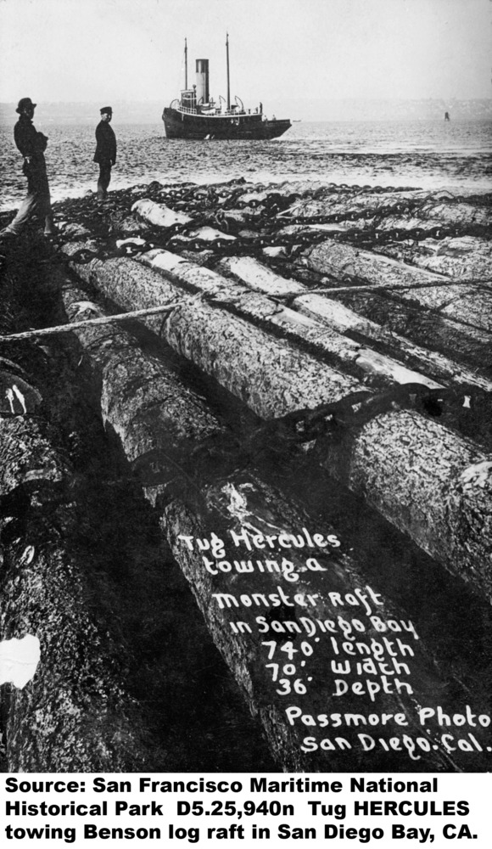
Sometime between 1908-1962

Slide 5
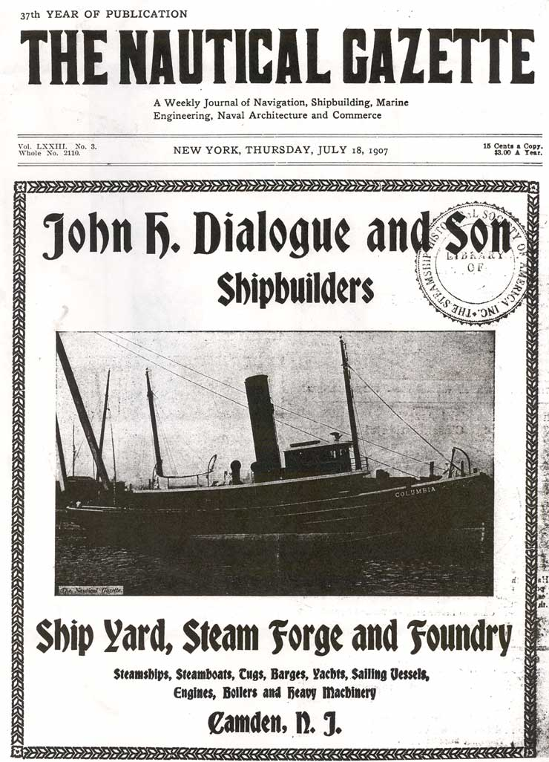
1907

Slide 6
Historic Structure Report
You turn in at night₁, und dere iss a lighthouse outside your cabin window. In de morning, you gets up--and were, py Yesus iss de same...lighthouse! You stand and talk mit somebody until you get sick of him, so you valk avay. You go around de deckhouse₂--und you run right into him head-on. Dese tugs iss so little you can’t get away from nobotty!
Go to sleep.
Another part of the towboat.

Slide 7
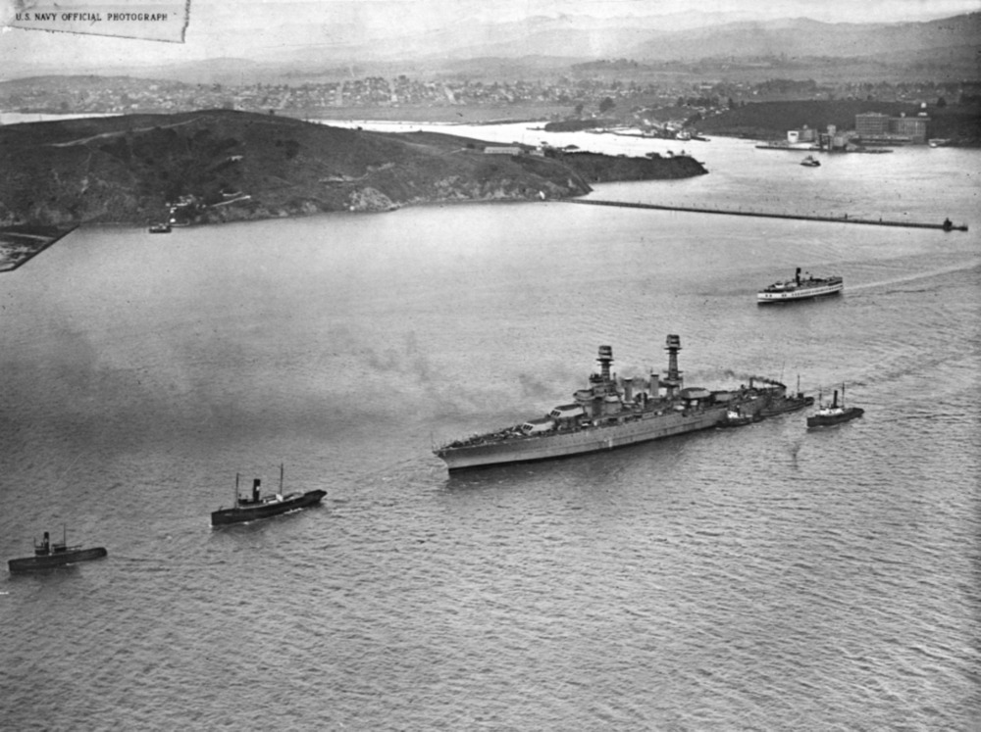
Circa 1920

Slide 8
Dan Thomsen’s Records
Circa 1908
It shut in thick with hail and rain squalls₁. The HERCULES stood up on end at times₂, and had it not been for the automatic towing machines on the whipping hawser₃ we would have parted₄. Some of the hands thought we would never weather it.
The weather was bad.
The boat tipped to one side.
Part of the boat.
Died.

Slide 9
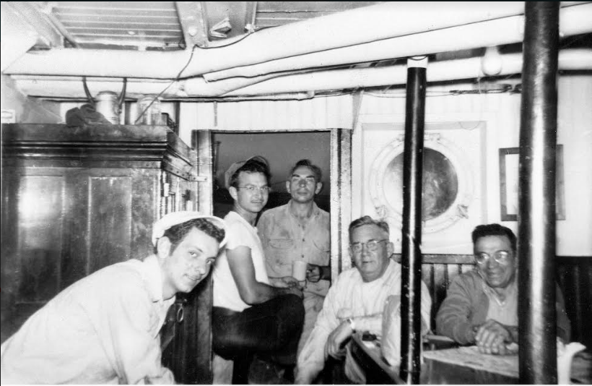
1950s

Slide 10
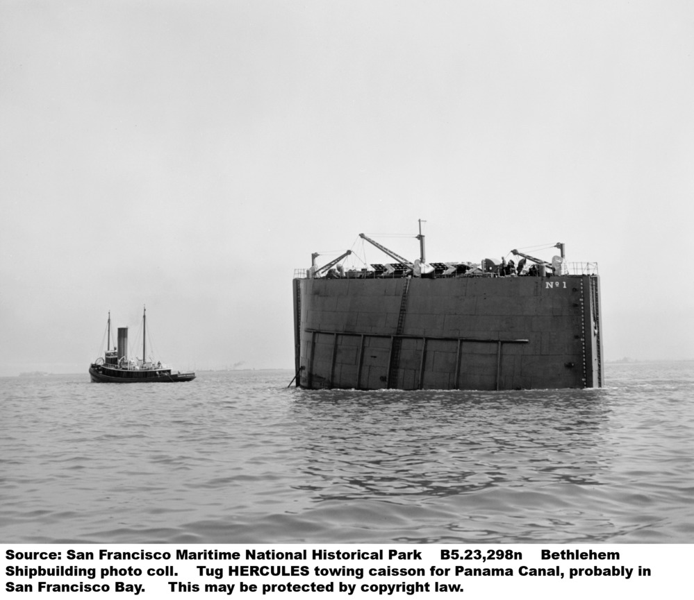
Circa 1910

